Slide 1
www.egra.london

Slide 2
EGRA Air Quality Monitoring
Our Objectives are to:
get evidence about the state of our air quality
identify critical pollution sites
raise public awareness about air quality
help campaigns to reduce air pollution

Slide 3
What Air Pollution?
SOX, NOX and Particulates – the last 2 are traffic-related
we are measuring Nitrogen Dioxide
because there are legal limits to that pollutant and
measuring it is easy and cheap
We were helped by www.cleanairuk.org

Slide 4
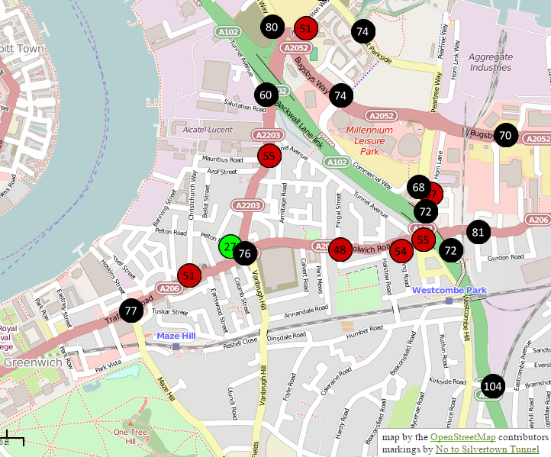
No to Silvertown Guided Locations

Slide 5
The Mechanics
adhered to DEFRA guidelines (one month over April)
had residents each sponsor an AQ tube
involved two local councillors (1 ward, 1 Chair of Highways)
trained a small team (4 effectively)
publicised the results in the media

Slide 6
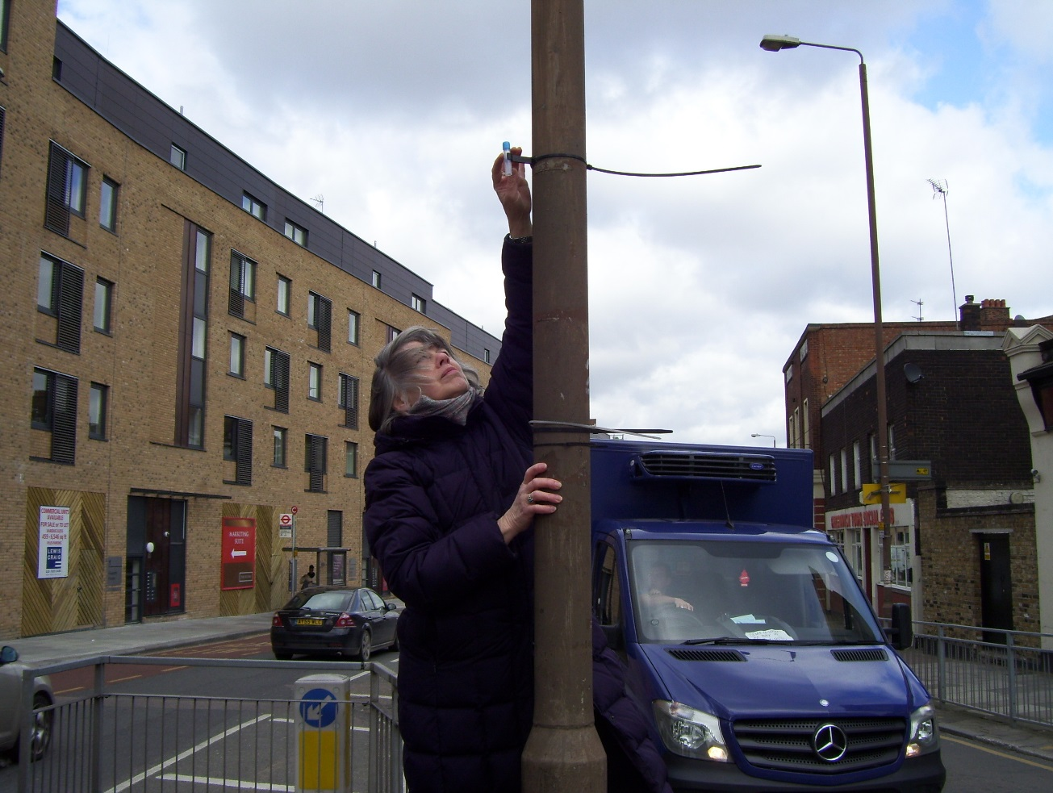
A Critical Junction

Slide 7
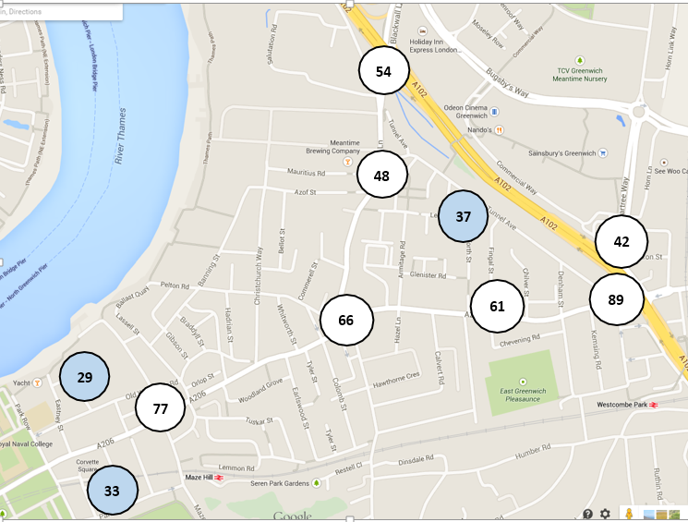
Locations and Results

Slide 8
Using the Information
discussions with Borough EH department
publicity campaigns
often around major developments
No to Silvertown tunnel
IKEA
new Sainsbury/M&S complex
new inner city “Bicester” style outlet village at 02
20,000 new dwellings on Greenwich peninsula

Slide 9
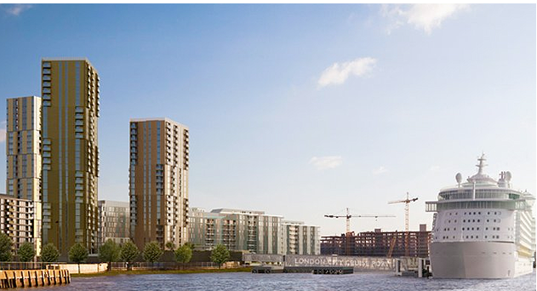
And the London Cruise Liner Terminal
2/3 ships a week all six summer months
used as floating hotels
burning a minimum of 700 litres/hour
of low grade diesel
often without emissions treatment
the equivalent of 400 idling trucks 24/7

Slide 10
Our Future Plans
we are funded to continue sample monitoring into 2016
we have a strategy to question every residential planning application on AQ grounds when near hotspots
we will work with citizen groups and specific campaigns
we will input to major policy consultations:
National strategy (September)
London guidelines (September)
Ultra Low Emission Zone

