Slide 1
Cleaner Air 4 London
@CleanerAir4LDN

Slide 2
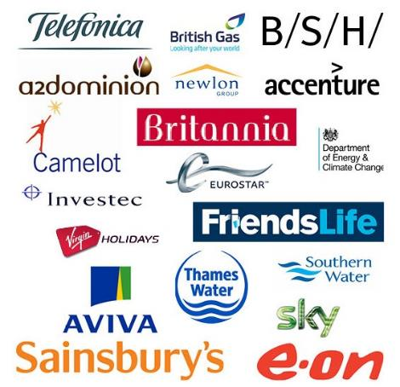
GLOBAL ACTION PLAN
We are an environmental behaviour change charity.
Focused on action, not talk
21 years experience
24 countries
What we do:
We inspire and help people to act.
We capture the impact.
We share lessons to create wider change.
Notes:
PW

Slide 3
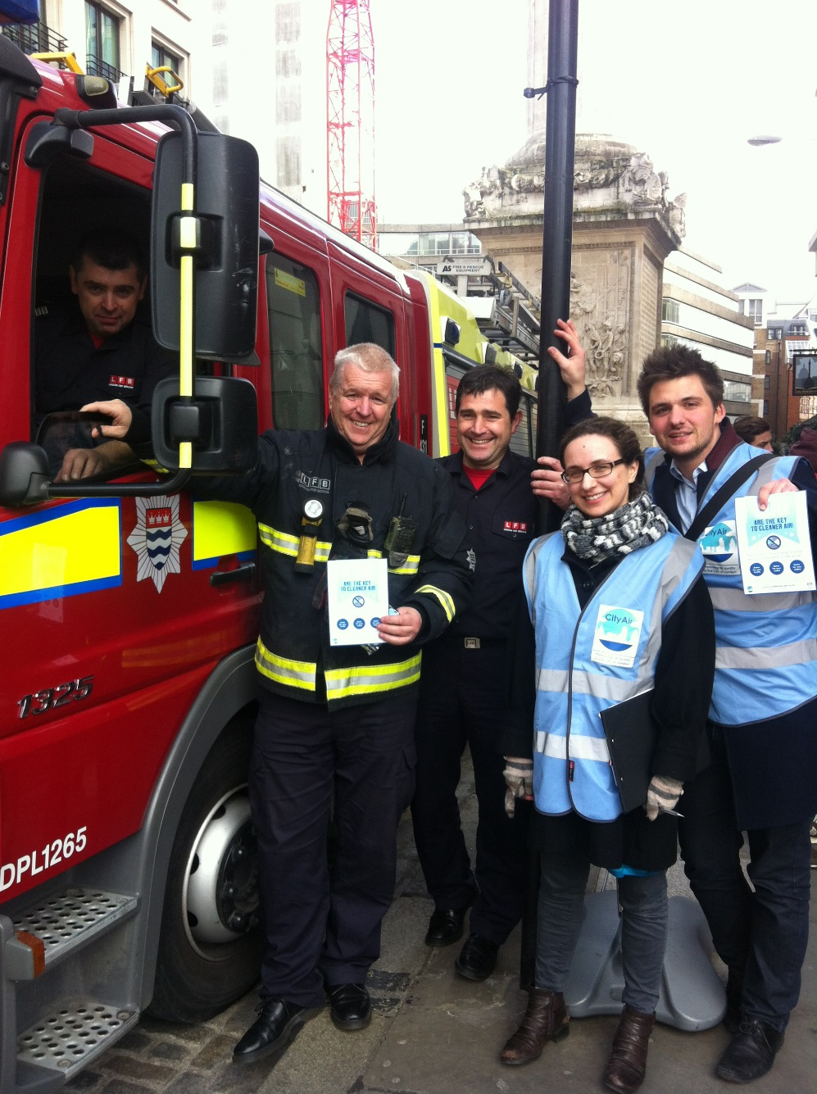
Cleaner air action days
14 Cleaner Air champions out on the streets of the Square Mile
521 drivers turned off
36 businesses participated
350 litres of fuel saved

Slide 4
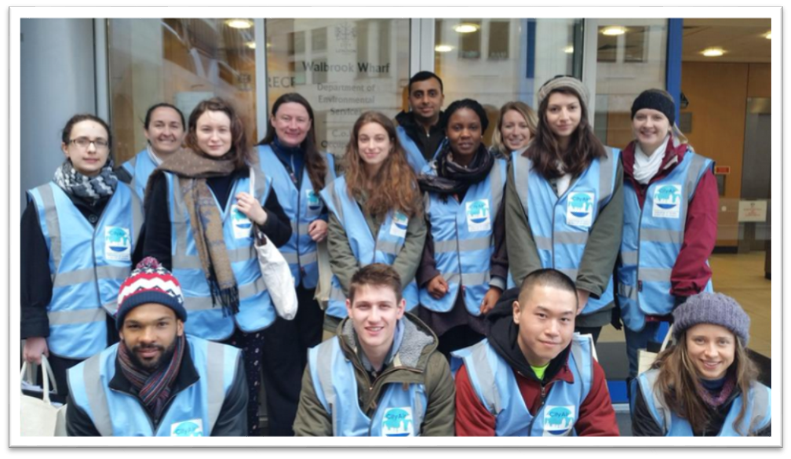
Future opportunity
40k litres of fuel or 20 Olympic swimming pools of CO₂ a year could be saved by just 512 drivers
Cross-London scale up
Proving longer-term behaviour change
Train the trainer
Notes:
Securing the support of businesses and using them as ‘trusted messengers’ to amplify the campaign.
Saying thank you to drivers who were not idling their engine. Rewarding positive behaviour was great to keep the morale of Air Quality Warden’s high and was received well by the drivers we approached.
Wearing a blue high visibility jacket gave Air Quality Wardens authority and they were easily recognisable walking the streets. These contributed to a high percentage of drivers turning off without being asked.
Working in pairs gave Air Quality Wardens added confidence to speak to drivers and they could learn from each other.
Simply asking drivers to switch off worked well.

Slide 5
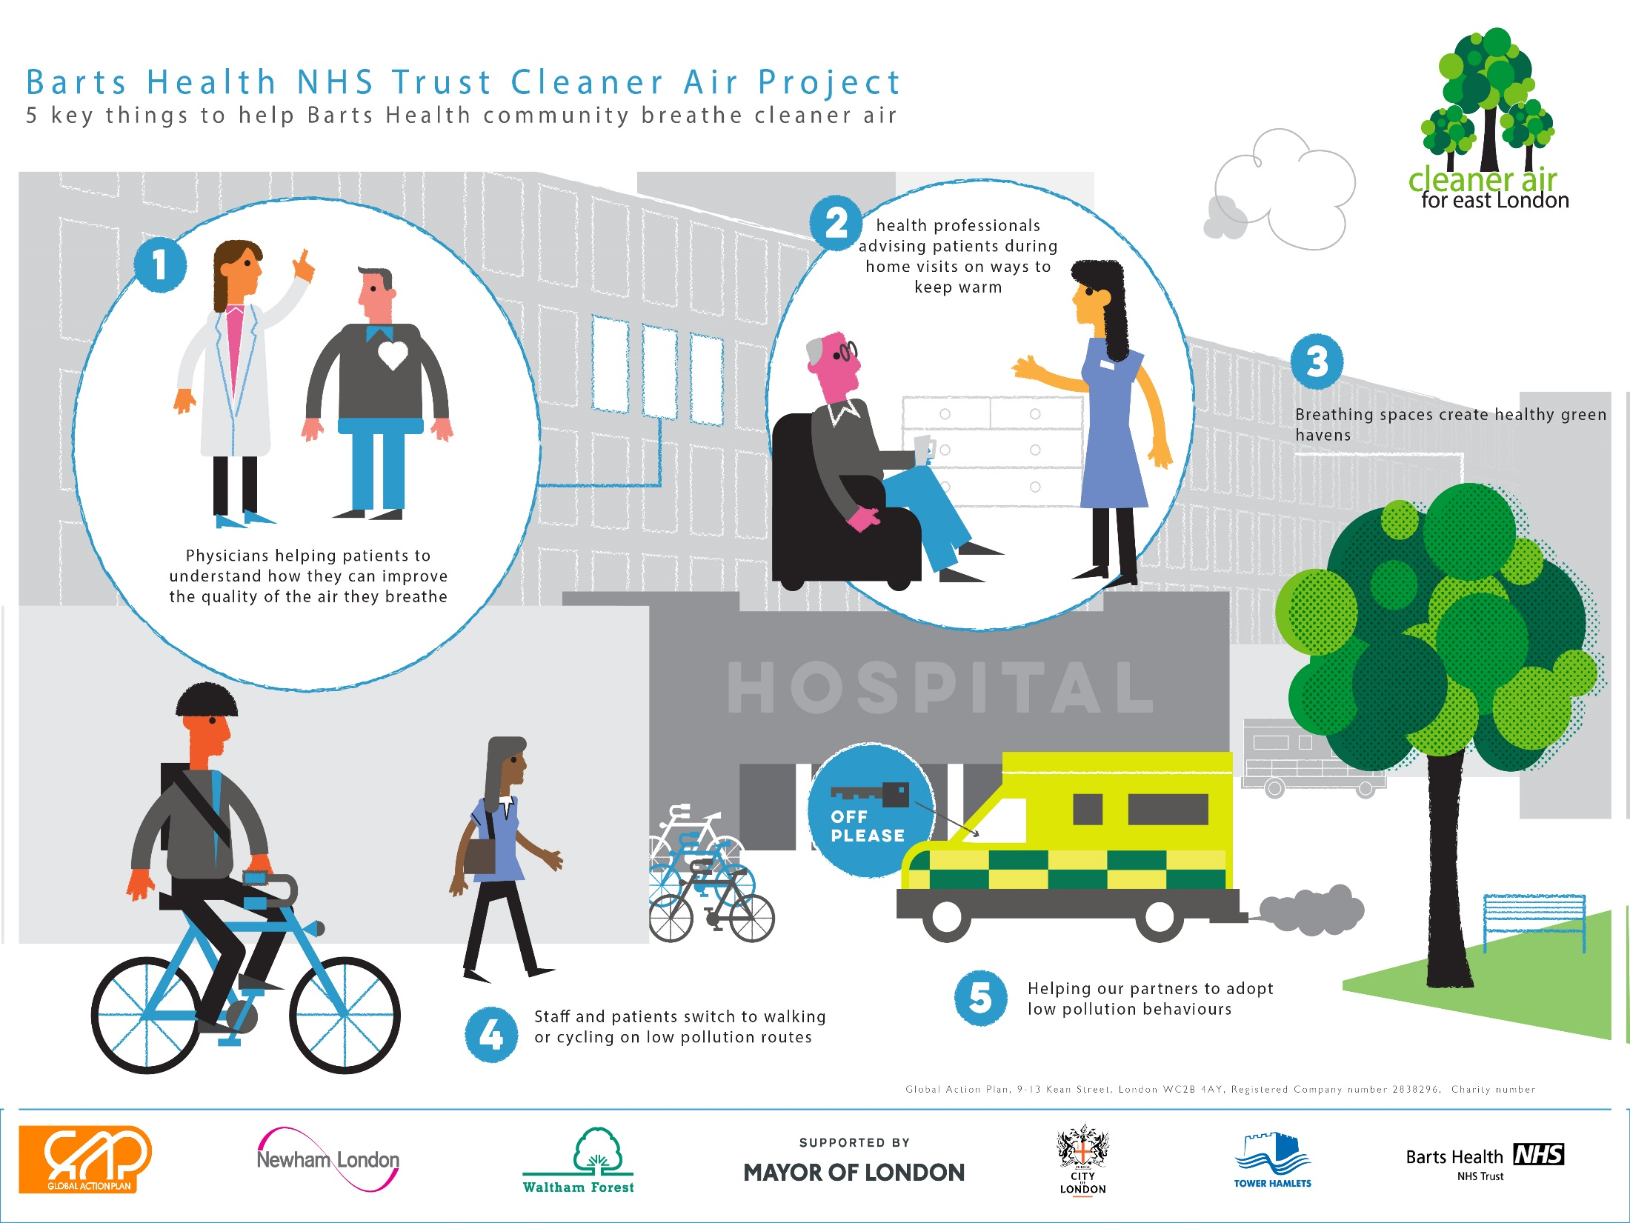

Slide 6
Warm & Well
Energy packs reached 828 patients
Through 157 clinicians
Health messenger 25% more effective than door drop

Slide 7
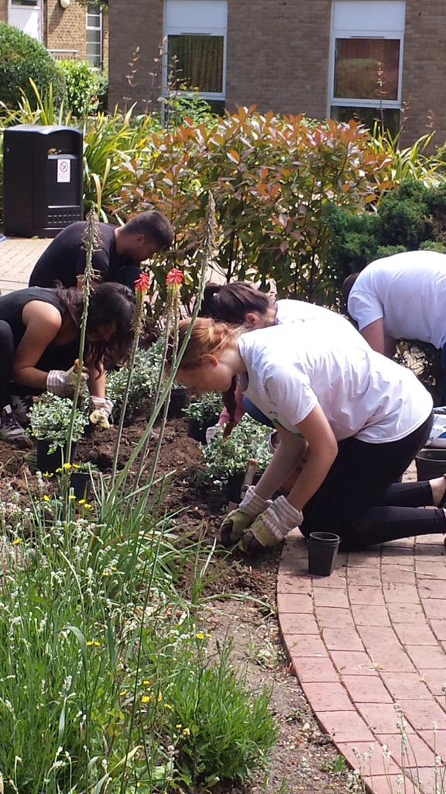
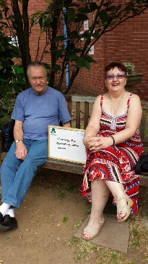
Breathing Spaces
Raising awareness of air pollution and health impacts on patients

Slide 8
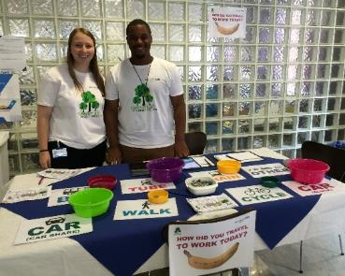
Switch Your Trip.ORG
4 week travel challenge
4-8% reduction staff car travel
Embedding into public health agenda

Slide 9
Pharmacists
Reaching 1,000 at risk patients with cleaner air messages

Slide 10
Trust Transport
Reduce Trust vehicle emissions (contractor vehicles, courier, taxi, other sector vehicles
Engage Trust drivers
Barts Health leading accreditation/award scheme

Slide 11
Looking for opportunities to roll out and scale up
Contact:
Caroline.watson@globalactionplan.org.uk

